Slide 1

Pharmaceutics 607:
Basic Pharmacodynamics
William J. Jusko, PhD
Pharmacy Room 404 wjjusko@buffalo.edu
July 21, 2023

Slide 2
Overview of Pharmacodynamics
Pillars of PK/PD and QSP (Quantitative and
Systems Pharmacology)
Basic terminology and definitions
Comparison of PK versus PD
Nonlinear receptor/target binding
Turnover concepts
Array of PK/PD models

Slide 3
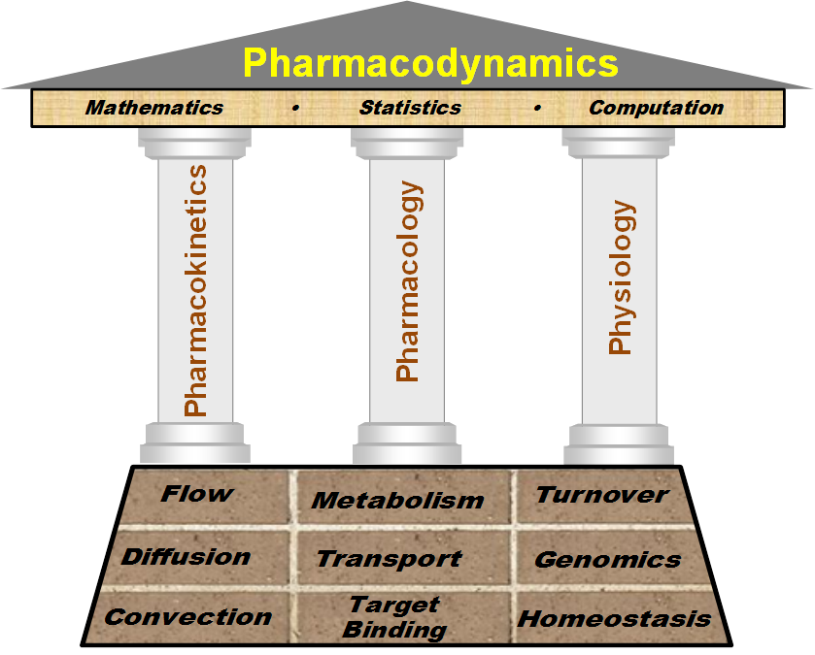
The Edifice*
The Science
Tools
Pillars
Foundation
*Definitions: An impressive structure; A complex system of beliefs

Slide 4
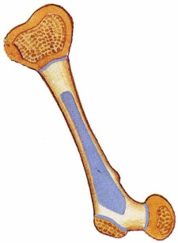
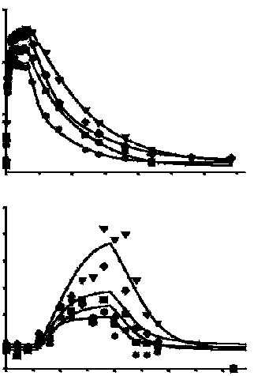
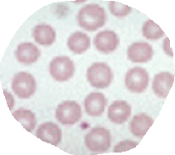
Pharmacodynamics (PD)
k_{in}
k_{in}
k_{in}
k
in
P
k
in
R
k
in
S(t)
C(t)
S(t)
S(t-T
S(t -T_{p})
S(t -T_{p}-T_{R})
C(t)
P
)
S(t-T
P
-T
R
)
Description of the time -
course and factors controlling
drug effects on the body.
Important are:
10000
SC
Doses
1000
Serum rHuEPO
Conc., IU/L
100
10
0
5
10
15
7
6
E_{max}
EC₅₀
k_{eo}, k_{in} , τ
= Capacity constant
= Sensitivity constant
= Various time constants
for specific models
5
Reticulocytes, %
4
3
2
1
0
5
10
15
20
Time, day
EPO stimulates
production of RBC.

Slide 5
PK vs PD
Whole body influence
Zero baseline
‘Simple’ determinants
Usually linear
Few assay methods/media
Alters specific subsystem
Starts from steady-state
Complex controls
Predominately nonlinear
Diverse measures
Components and processes can be described with
models and equations allowing conceptualization,
quantification, and prediction.

Slide 6
Basic Tenets of Pharmacodynamics
Capacity-Limitation Turnover and Homeostasis
Production
Biological
Factor
(R)
Loss
Effect, %
Hill Function
Concentration
O-order 1st-order
The Law of Mass Action
( D + R DR ) and small
quantity of targets leads
to capacity-limitations
in most responses.
Both diseases and therapeutic
agents often interfere with the
homeostasis in the body resulting
from the natural turnover of
biological substances or functions.

Slide 7
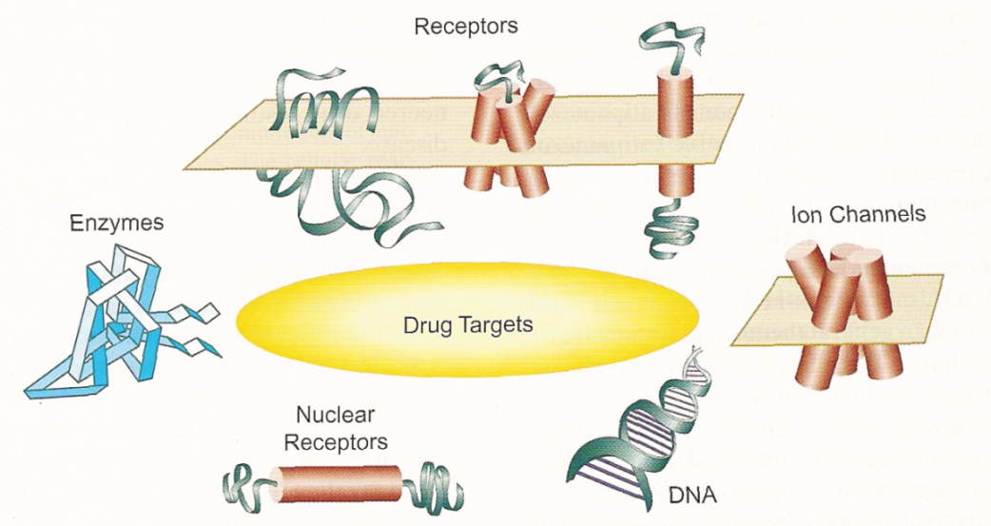
Receptor Categories – Drug Targets
Kenakin. A Pharmacology Primer (2004).

Slide 8
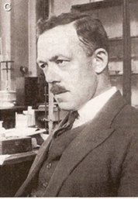
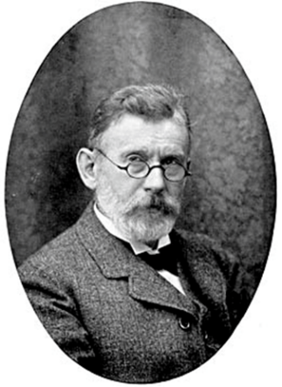
Clark’s Occupancy Theory
AJ Clark (1933) proposed the first model to account for
the quantitative behavior of a receptor-mediated process.
k₁
R + L
RL • • • • • Effect
k₋₁
Effect
or
RL
Transduction & Translation
L
Paul Ehrlich (1913) coined ‘Receptors’
“Corpora non agunt nisi fixata.”
(Substances do not act unless bound.)

Slide 9
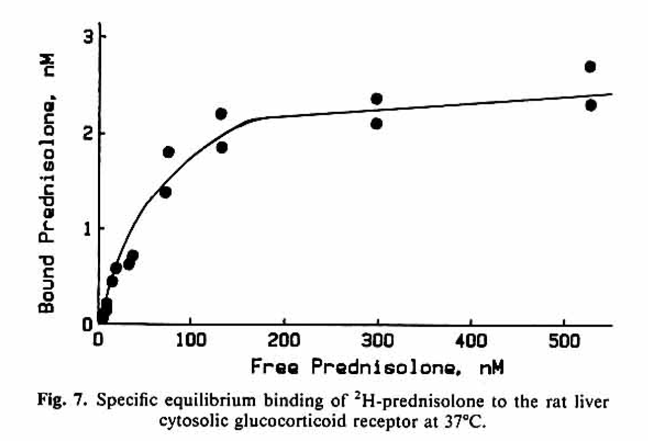
Receptor Binding of Prednisolone
The GR belongs to the nuclear receptor superfamily of transcription factors.
Bmax = 2.5 nM
KD = 80 nM …….nM or less is common
Equilibrium binding study of glucocorticoid receptors (GR) harvested by ultracentrifugation of cytosol from rat liver with charcoal separation of free (Df) from bound (Db) drug.
Boudinot D et al., JPB 14: 469 (1986).

Slide 10
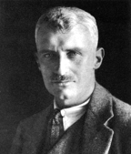
Hill
Function:
E_{max} = Capacity
EC₅₀ = Sensitivity
γ = Hill Factor
100
80
60
40
20
0
γ
= 2
1
0.5
Effect, %
  0 20 40 60 80
Concentration
Hill AV , The possible effect of the aggregation of molecules of haemoglobin
on its dissociation curve, J. Physiol. (London) 40: iv (1910).

Slide 11
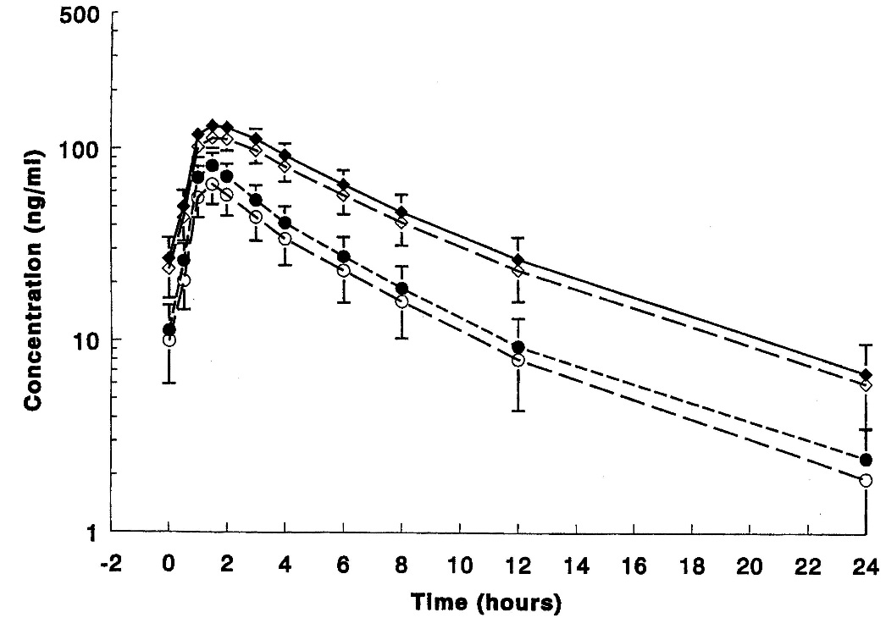
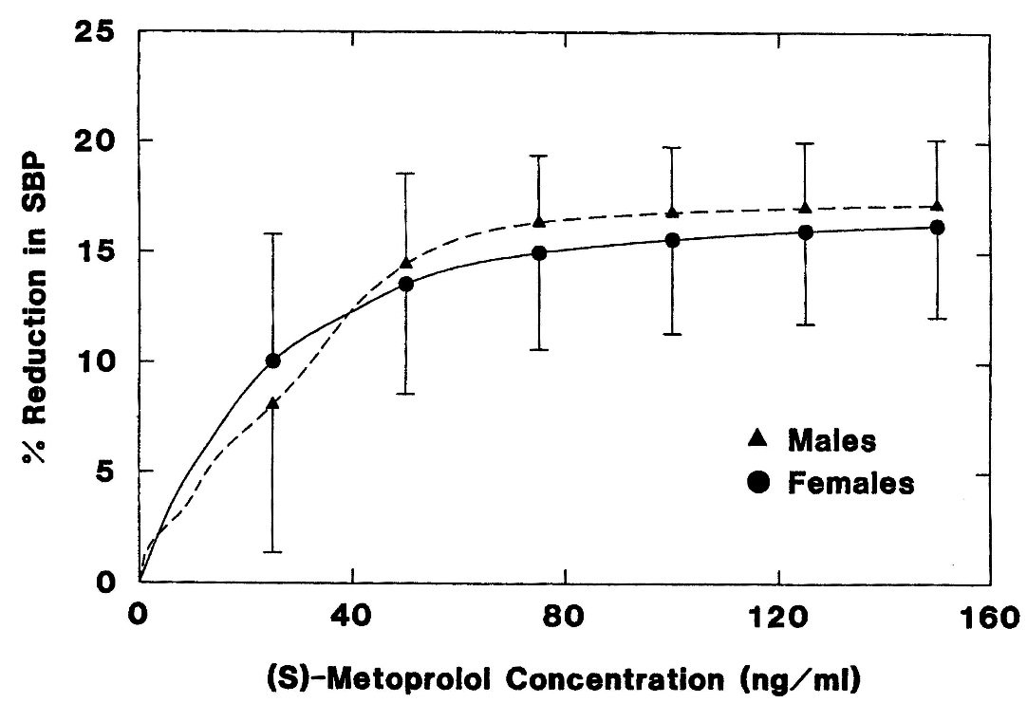
Metoprolol PK/PD in Relation to Sex
A.B. Luzier et al, Clin. Pharmacol. Ther. 66: 594-601, 1999.
CYP2D6
100 mg BID
Females
Males
Clearances (L/hr/kg)
Pharmacodynamics: Systolic BP
Men Women
(S)-metoprolol 2.21 1.16
(R)-metoprolol 3.40 1.44
Men Women
E_{max}, % 18.0 17.8
EC₅₀, ng/ml 28.1 25.4

Slide 12
Processes Described by Capacity-Limited Relationships
Process
Metabolic Rate
Transport Rate
Protein Binding
(D_{b} = Bound Drug)
Receptor Binding
(B_{sp} = Bound Drug)
Pharmacologic Effect
(E)
Transduction
Equation
Origin
Michaelis-Menten (1913)
Shannon (1939)
Goldstein (1949)
Clark (1933)
Hill (1910)
Black & Leff (1983)
WJ Jusko, J Clin Pharmacol 29: 488 - 493 (1989)

Slide 13
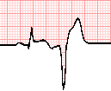
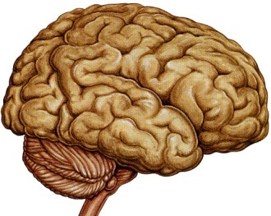

Biological Turnover Rates of Structures or Functions
Fast
Slow
Electrical Signals (msec)
Neurotransmitters (msec)
Chemical Signals (min)
Mediators, Electrolytes (min)
Hormones (hr)
mRNA (hr)
Proteins / Enzymes (hr)
Cells (days)
Tissues (mo)
Organs (year)
People ( 1 century)
S
Y
S
T
E
M
S
M
O
D
E
L
S
B
I
O
M
A
R
K
E
R
S
Direct
Effect
Models
Turnover
Models
C
L
I
N
I
C
A
L
Transduction
Models

Slide 14

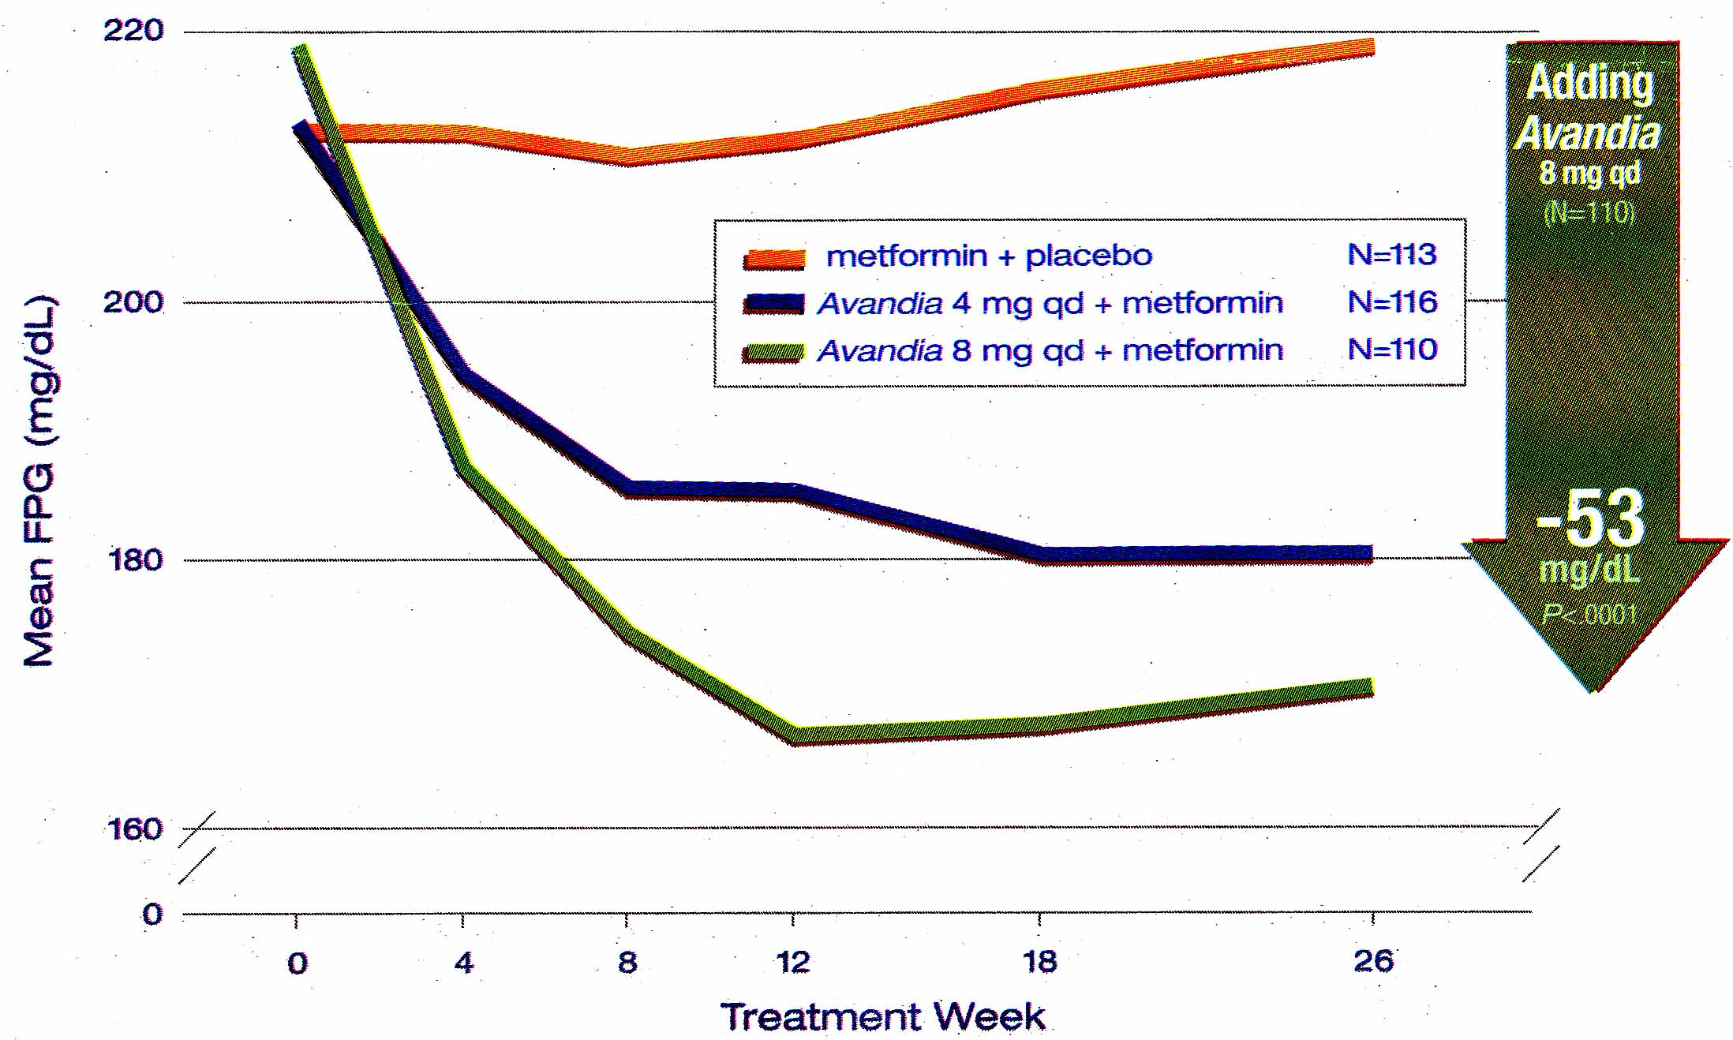
Typical Profile of Anti-Diabetic Agent:
8 mg

Slide 15
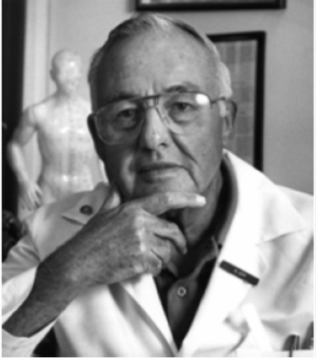
Kinetics of Pharmacologic Effects
Gerhard Levy, Clin Pharmacol Ther 7:362 (1966)
PK
Pharmacology
E
ln C
t
PD
ln C
E_{o}
Father of
Pharmacodynamics
E
NB. Eo is not baseline
t

Slide 16
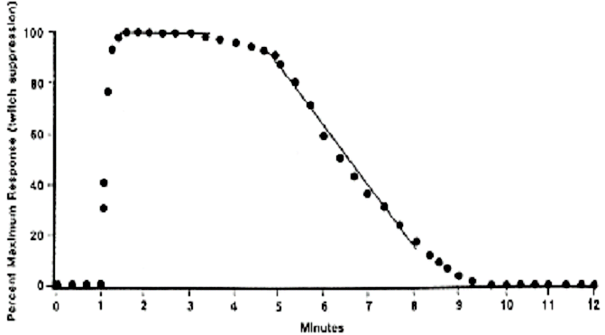
Time Course of a Rapidly Reversible Direct Drug Effect: Succinylcholine
NB:
Plateau (Emax)
Decline phase
Dose: 0.5 mg.kg⁻¹ IV
From: Walts and Dillon, Anesthesiology, 28: 372-376, 1967

Slide 17
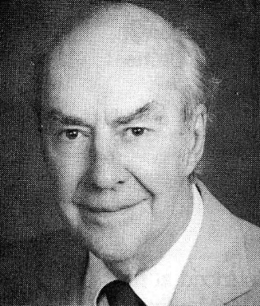
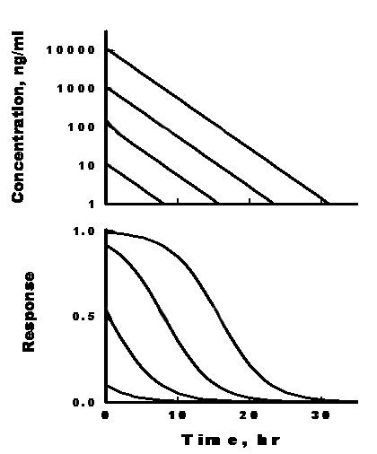
PK/PD Expectations For Simple
Direct Effects: Signature Profiles
J. G. Wagner
Kinetics of
Pharmacologic
Response
J Theor Biol
20: 173 (1968)

Slide 18
Duration of Effect:
Influence of Dose and k (kel)
k
ln C
t
Cmin is at some
minimal effect

Slide 19
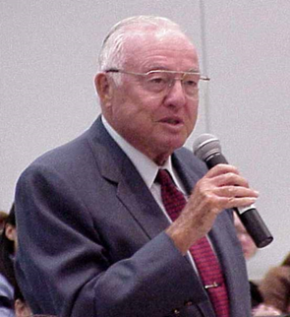
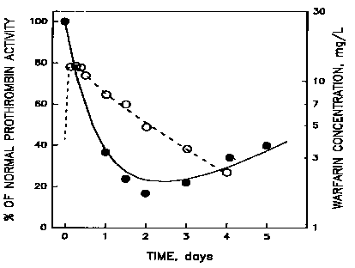
Warfarin: Example of Inhibition of k_{in}
k_{syn}
k_{deg}
PROTHROMBIN
COMPLEX
ACTIVITY
IC₅₀
G. Levy
coined
“Indirect
Response”
The first PK/PD analysis of IDR data was carried out by Nagashima et al (Clin. Pharmacol. Ther. 10: 22, 1969) who characterized Prothrombin Complex Activity (PCA) in blood () following oral doses (1.5 mg/kg) of warfarin (○, plasma concentrations). Warfarin inhibits Vitamin K-dependent synthesis of PCA and thus produces Model I behavior. Data reanalyzed by Jusko and Ko, CPT 56: 406 (1994).

Slide 20
Family of Indirect Response Models
I. INHIBITION - k_{in}
II. INHIBITION - k_{out}
R₀
R
R
R₀
k_{in}
Response
(R)
k_{out}
Time
k_{in}
Response
(R)
k_{out}
Time
IC₅₀
IC₅₀
I_{max}
I_{max}
III. STIMULATION - k_{in}
IV. STIMULATION - k_{out}
R
R₀
R₀
R
k_{in}
Response
(R)
k_{out}
k_{in}
Response
(R)
k_{out}
Time
Time
SC₅₀
SC₅₀
S_{max}
S_{max}
Levy et al, CPT 10: 22(1964), Dayneka, Garg, Jusko, JPB 21: 457 (1993),
Sharma A and Jusko WJ, Br. J. Clin. Pharmacol. 45: 229 (1998)

Slide 21
Array of Basic PD Models
C_{p}
+
Receptor
C_{P}
C_{E}
k_{eo}
Effect
CL
k_{on}
k_{off}
CL
Drug – Receptor complex
Effect
Biophase
Slow Target Binding
k_{kill}
k_{in}
k_{out}
C_{P}
k_{g}
R
R
Effect
k C_{p}
CL
Cell Growth & Loss
Direct
Turnover & Inactivation
k_{in}
Response (R)
k_{out}
E_{r}
τ
τ
E₂
τ
E₃
τ
E₁
Indirect Response
Transduction

Slide 22
Summary
PK/PD Modeling is extensively used in assessing effects of small and large molecule therapeutic agents.
PK, Target Binding, and Turnover are
key components of numerous models.
  An array of basic and complex PK/PD models can be applied to diverse drugs.

